Slide 1
Database system and Applications IS ZC337 Prof. Uma Maheswari

Slide 2
Tutorial Session 6:
Data storage, Indexing

Slide 3
LEARNING OUTCOME
Secondary storage devices (Files, records, blocks on disks)
B and B+ trees
Hashing techniques(internal & external)
REFER: T1-Chapter 13
Sections: 13.1-13.8

Slide 4
Disk Parameters Calculation:
Usually, the disk manufacturer provides an average seek time in milliseconds.
The typical range of average seek time is 4 to 10 msec.
If the speed of disk rotation is p revolutions per minute (rpm), then the average
rotational delay rd is given by
rd = (1/2) * (1/p) min= (60 * 1000)/(2 * p) msec = 30000/p msec.
Block transfer time (btt) = B/tr msec where B is Block size and tr is transfer rate.
Transfer rate = track size in bytes / 1 rpm.
The average time (s) needed to find and transfer a block, given its block address, is estimated by (s + rd + btt) msec.

Slide 5
Disk Parameters Calculation:
The rotational delay for all but the first block, so the estimate for transferring k consecutive blocks is s + rd + (k * btt) msec.
bulk transfer rate (btr) that takes the gap size into account when reading consecutively stored blocks. If the gap size is G bytes, then
btr = (B/(B + G)) * tr bytes/msec.
To transfer consecutively k noncontiguous blocks that are on the same cylinder, we need approximately s + (k * (rd + btt)) msec.
The estimated time to read k blocks consecutively stored on the same cylinder becomes s + rd + (k * (B/btr)) msec.

Slide 6
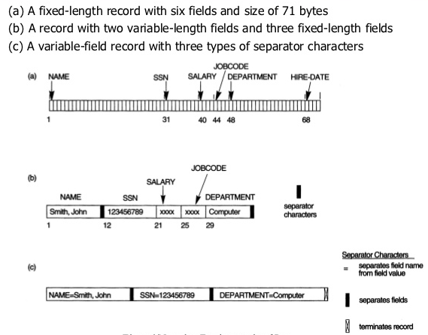
Placing file records on Disk

Slide 7
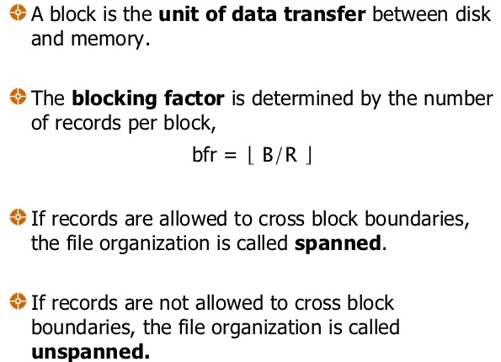
Placing file records on Disk

Slide 8
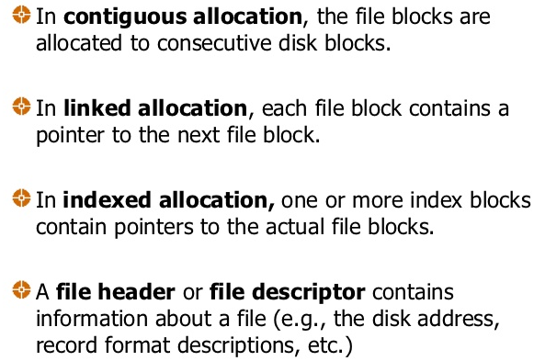
Placing file records on Disk

Slide 9
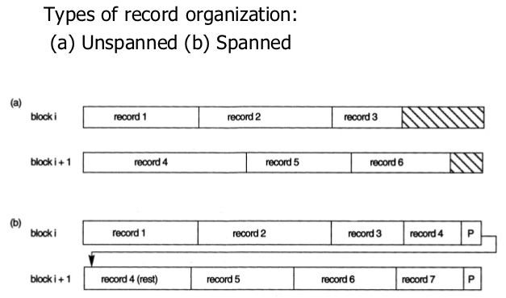
Placing file records on Disk

Slide 10
Disk Parameters Calculation:
Formula
Usually, the disk manufacturer provides an average seek time in milliseconds.
The typical range of average seek time is 4 to 10 msec.
If the speed of disk rotation is p revolutions per minute (rpm), then the average
rotational delay rd is given by
rd = (1/2) * (1/p) min= (60 * 1000)/(2 * p) msec = 30000/p msec.
1 rpm = 60 x 1000 / rpm msec
And rd = (1 rpm) /2
D. Block transfer time (btt) = B/tr msec where B is Block size and tr is transfer rate.
E. Transfer rate = track size in bytes / 1 rpm.
F. The average time (s) needed to find and transfer a block, given its block address, is estimated by (s + rd + btt) msec.
G. To transfer consecutively k noncontiguous blocks that are on the same cylinder, we need approximately s + (k * (rd + btt)) msec.
The rotational delay for all but the first block, so the estimate for transferring k consecutive blocks is s + rd + (k * btt) msec.
bulk transfer rate (btr) that takes the gap size into account when reading consecutively stored blocks. If the gap size is G bytes, then
btr = (B/(B + G)) * tr bytes/msec.
J. The estimated time to read k blocks consecutively stored on the same cylinder becomes
s + rd + (k * (B/btr)) msec1
k. Blocking factor = Bfr = floor(B/R) where B – block size in bytes and R is record size in bytes.

Slide 11
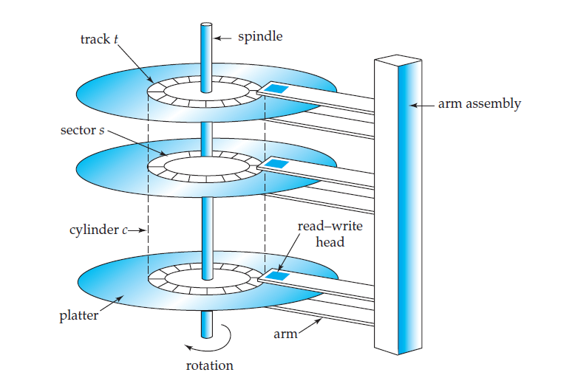

Slide 12
Problem
Consider a disk with the following characteristics (these are not parameters of any particular disk unit): block size B=512 bytes, interblock gap size G=128 bytes, number of blocks per track=20, number of tracks per surface=400. A disk pack consists of 15 double-sided disks.
(a) What is the total capacity of a track and what is its useful capacity (excluding interblock gaps)?
(b) How many cylinders are there?
(c) What is the total capacity and the useful capacity of a cylinder?
(d) What is the total capacity and the useful capacity of a disk pack?
(e) Suppose the disk drive rotates the disk pack at a speed of 2400 rpm (revolutions per minute); what is the transfer rate in bytes/msec and the block transfer time btt in msec? What is the average rotational delay rd in msec? What is the bulk transfer rate?
(f) Suppose the average seek time is 30 msec. How much time does it take (on the average) in msec to locate and transfer a single block given its block address?
(g) Calculate the average time it would take to transfer 20 random blocks and compare it with the time it would take to transfer 20 consecutive blocks using double buffering to save seek time and rotational delay.

Slide 13
a) What is the total capacity of a track and what is its useful capacity (excluding interblock gaps)?
block size B=512 bytes,
interblock gap size G=128 bytes,
number of blocks per track=20,
number of tracks per surface=400.
A disk pack consists of 15 double-sided disks.
NOTE : Write the units after computed values.

Slide 14
b) How many cylinders are there?
block size B=512 bytes,
interblock gap size G=128 bytes,
number of blocks per track=20,
number of tracks per surface=400.
A disk pack consists of 15 double-sided disks.
NOTE : Write the units after computed values.

Slide 15
(c) What is the total capacity and the useful capacity of a cylinder?
block size B=512 bytes,
interblock gap size G=128 bytes,
number of blocks per track=20,
number of tracks per surface=400.
A disk pack consists of 15 double-sided disks.
NOTE : Write the units after computed values.

Slide 16
(d) What is the total capacity and the useful capacity of a disk pack?
block size B=512 bytes,
interblock gap size G=128 bytes,
number of blocks per track=20,
number of tracks per surface=400.
A disk pack consists of 15 double-sided disks.
NOTE : Write the units after computed values.

Slide 17
(e) Suppose the disk drive rotates the disk pack at a speed of 2400 rpm (revolutions per minute); what is the transfer rate in bytes/msec and the block transfer time btt in msec? What is the average rotational delay rd in msec? What is the bulk transfer rate?
block size B=512 bytes,
interblock gap size G=128 bytes,
number of blocks per track=20,
number of tracks per surface=400.
A disk pack consists of 15 double-sided disks.
NOTE : Write the units after computed values.

Slide 18
(f) Suppose the average seek time is 30 msec. How much time does it take (on the average) in msec to locate and transfer a single block given its block address?
block size B=512 bytes,
interblock gap size G=128 bytes,
number of blocks per track=20,
number of tracks per surface=400.
A disk pack consists of 15 double-sided disks.
NOTE : Write the units after computed values.

Slide 19
(g) Calculate the average time it would take to transfer 20 random blocks and compare it with the time it would take to transfer 20 consecutive blocks using double buffering to save seek time and rotational delay.
block size B=512 bytes,
interblock gap size G=128 bytes,
number of blocks per track=20,
number of tracks per surface=400.
A disk pack consists of 15 double-sided disks.
NOTE : Write the units after computed values.

Slide 20
Solution
(a) Using the block size B=512 bytes, interblock gap size G=128 bytes, number of blocks per track=20,
Now calculate 1 block storing capacity = 1 block size + I Gap) =
= (512 +128) = 640 bytes
For 1 track which has 20 blocks and so its storage capacity = (Total track size
= 20 * (512+128)
= 12800 bytes = 12.8 Kbytes
Useful capacity of a track = 20 * 512 = 10240 bytes = 10.24 Kbytes
(ie., excluding the gap size)
(d) since number of tracks per surface=400.
Total capacity of a disk pack = 15 * 2 * 400 * 20 * (512+128)
= 153600000 bytes = 153.6 Mbytes
Useful capacity of a disk pack = 15 * 2 * 400 * 20 * 512
(ie., excluding gap size) = 122.88 Mbytes
(b) Number of cylinders = number of tracks = 400
(c) since a disk pack consists of 15 double-sided disks.
Total cylinder capacity = 15*2*20*(512+128)
= 384000 bytes = 384 Kbytes
Useful cylinder capacity = 15 * 2 * 20 * 512
(ie., excluding the gap size) = 307200 bytes = 307.2 Kbytes
NOTE : Write the units after computed values.

Slide 21
Solution
(e) Using the above FORMULA H
Transfer rate = track size in bytes / 1 rpm.
Transfer rate tr= (total track size in bytes)/(time for one disk revolution in msec)
tr= (12800) / ( (60 * 1000) / (2400) ) = (12800) / (25) = 512 bytes/msec
Using the above formula G
Block transfer time (btt) = B/tr msec where B is Block size and tr is transfer rate.
block transfer time btt = B / tr = 512 / 512 = 1 msec
Using the above formula G
If the speed of disk rotation is p revolutions per minute (rpm), then the average
rotational delay rd is given by rd = (1/2) * (1/p) min
average rotational delay rd = (time for one disk revolution in msec) / 2
= 25 / 2
= 12.5 msec
Using the above formula
bulk transfer rate (btr) that takes the gap size into account when reading consecutively stored blocks. If the gap size is G bytes, then btr = (B/(B + G)) * tr bytes/msec.
bulk transfer rate btr= tr * ( B/(B+G) )
= 512*(512/640)
= 409.6 bytes/msec
(g) So now using calculated from previous step
time to transfer 20 random blocks = 20 * (s + rd + btt) = 20 * 43.5 = 870 msec
time to transfer 20 consecutive blocks using double buffering
= s + rd + 20*btt = 30 + 12.5 + (20*1) = 62.5 msec
(a more accurate estimate of the latter can be calculated using the bulk transfer
rate as follows:
time to transfer 20 consecutive blocks using double buffering
= s+rd+((20*B)/btr) = 30+12.5+ (10240/409.6) = 42.5+ 25 = 67.5 msec)
(f)
Using the above formula
The average time (s) needed to find and transfer a block, given its block address, is estimated by (s + rd + btt) msec.
average time to locate and transfer a block = s+rd+btt
= 30+12.5+1 = 43.5 msec
NOTE : Write the units after computed values.

Slide 22
Problem
Let us say we have XAT supplier company has stored info on files.
A Supplier file has rec = 1000 records of fixed length.
Each record has the following fields/cols (in bytes) :
sup# (10), part# ( 10) , pname(200) pdescp(700) and a deletion marker byte.
The file is stored on the disk whose parameters are given as block size B = 1024 bytes; interblock gap size G = 200bytes; number of blocks per track = 25; number of tracks per surface = 500. A disk pack consists of 18 double-sided disks, seek time s= 20msec, rotational delay rd = 12.5 and rpm=2000 msec.
a. Calculate the record size in bytes.
b. Calculate the blocking factor and the number of file blocks b, assuming an unspanned organization.
c. Calculate the average time it takes to find a record by doing a linear search on the file if
(i) the file blocks are stored contiguously, and double buffering is used;
(ii) the file blocks are not stored contiguously.
d. Assume that the file is ordered by part#; by doing a binary search, calculate the time it takes to search for a record given its part# value.

Slide 23
Solution
a. Calculate the record size in bytes.
A Supplier file has rec = 1000 records of fixed length. Each record has the following fields/cols (in bytes) : sup# (10), part# ( 10) , pname(200) pdescp(700) and a deletion marker byte.
block size B = 1024 bytes; interblock gap size G = 200bytes; number of blocks per track = 25; number of tracks per surface = 500. A disk pack consists of 18 double-sided disks, seek time s= 20msec, rotational delay rd = 12.5 and rpm=2000 msec.
b. Calculate the blocking factor and the number of file blocks b, assuming an unspanned organization.Understand unspanned ie., if the last record cannot fit in that block that whole record is stored in the next consecutive or stored in a different block.
NOTE : Write the units after computed values.

Slide 24
Solution
c. Calculate the average time it takes to find a record by doing a linear search on the file
(i)The file blocks are stored contiguously, and double buffering is used;
A Supplier file has rec = 1000 records of fixed length. Each record has the following fields/cols (in bytes) : sup# (10), part# ( 10) , pname(200) pdescp(700) and a deletion marker byte.
block size B = 1024 bytes; interblock gap size G = 200bytes; number of blocks per track = 25; number of tracks per surface = 500. A disk pack consists of 18 double-sided disks, seek time s= 20msec, rotational delay rd = 12.5 and rpm=2000 msec.
NOTE : Write the units after computed values.

Slide 25
Solution
A Supplier file has rec = 1000 records of fixed length. Each record has the following fields/cols (in bytes) : sup# (10), part# ( 10) , pname(200) pdescp(700) and a deletion marker byte.
block size B = 1024 bytes; interblock gap size G = 200bytes; number of blocks per track = 25; number of tracks per surface = 500. A disk pack consists of 18 double-sided disks, seek time s= 20msec, rotational delay rd = 12.5 and rpm=2000 msec.
(ii) the file blocks are not stored contiguously.
d. Assume that the file is ordered by part#; by doing a binary search, calculate the time it takes to search for a record given its part# value.
NOTE : Write the units after computed values.

Slide 26
Solution
Calculate the record size in bytes.
Record size = 10 + 10+ 200+ 700 +1 = 921 bytes.
b. Calculate the blocking factor and the number of file blocks b, assuming an unspanned organization.
Understand unspanned ie., if the last record cannot fit in that block that whole record is stored in the next consecutive or stored in a different block.
Using formula from above
Blocking factor = Bfr = floor(B/R)
where B – block size in bytes and R is record size in bytes.
Given in the problem block size B = 1024 bytes; interblock gap size G = 200bytes; number of blocks per track = 25; number of tracks per surface = 500.
B = 1024 bytes
Bfr = floor(B/R) = floor(1024/921)= floor(1.113) = 1.
(ie., 1 record in one block)
Therefore for 1000 records we need 1000 blocks.
b = ceil(rec/ bfr) = ceil(1000/1) = 1000 blocks.

Slide 27
Solution
c. Calculate the average time it takes to find a record by doing a linear search on the file
Using the formula:
The average time to do linear search is searching half the total file blocks
Hbs= b/2
The average time to do linear search = Hbs = b/2= 1000/2=500 blocks.
Total track size = 25 * (1024+200) = 30600 bytes
Time for 1 revolution of disk (ie 1 rpm) = 60 x 1000 / rpm = 60 x 1000/2000 = 30 msec
(i)The file blocks are stored contiguously, and double buffering is used;
= s+rd+(Hbs *B/btr)
where Hbs = 500, tr = track size/ 1 rpm = 30600 bytes /30 msec, calculate btr = (B/(B+G)) x tr , seek time s=20 msec, rd= 12.5.
tr = 30600/30 = 1020 bytes/msec
Given in the problem block size B = 1024 bytes; interblock gap size G = 200bytes; number of blocks per track = 25; number of tracks per surface = 500.
btr = ( 1024/(1024 + 200)) x 1020 = 853 bytes/msec
= s+rd+(Hbs *B/btr)
=20 +12.5 +(500 *(1024/853))=632.7344 msec= 0.632734 sec

Slide 28
Solution
(ii) the file blocks are not stored contiguously.
Similarly calculate using the following equation:
= Hbs *( s+rd +btt)
where btt = B/tr where tr = number of bytes on a track/ 1 rpm = 30600 bytes /30 msec
, Hbs =500 and B =1024
Btt = 1024 /( 30600/30) = 1.004
Given seek time s=20 msec, rd= 12.5.
So , = Hbs *( s+rd +btt) = 500 * (20 +12.5 +1.004)
= 18252 msec.
Assume that the file is ordered by part#; by doing a binary search, calculate the time it takes to search for a record given its part# value.
= ceil(log ₂b) *(s+rd+btt)
Since b is 1000 blocks .(calculated above)
= ceil (log ₂1000) x (20+12.5+ 1.004) = ceil (log ₂1000) x (33.504) = ceil(9.9) x33.504 = 10 x 33.504= 335.04 msec
NOTE : Write the units after computed values.

Slide 29
Question?
Without rearranging the actual records can you put them in particular order based on a key field or fields?
Sol:
By Indexing or Hashing.
Indexing is like Index at the end of Book , so you need to search linearly or binary to get to that term and find page number where that term is in the book. So catch is file (actual data) and a index to it is needed.
Hashing is O(1) doesn’t need to search but computes the data location in the file.

Slide 30
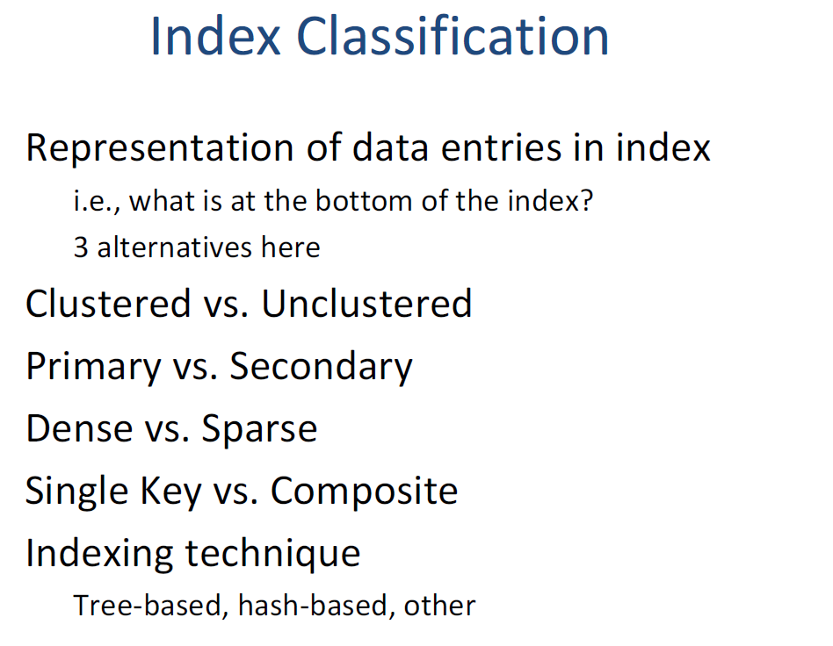

Slide 31
B+ TREE Tutorials

Slide 32
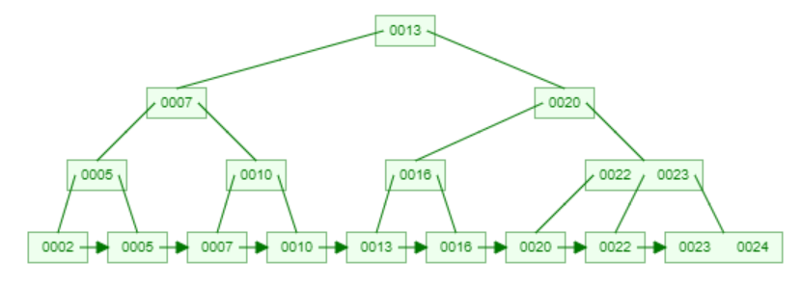
CRUD on B+ tree
Create a B+tree
2,5,7,10,13,16,23,24
Delete 23,10

Slide 33
CRUD on B+ tree
Delete 23,10

Slide 34
HASHING TECHNIQUE

Slide 35
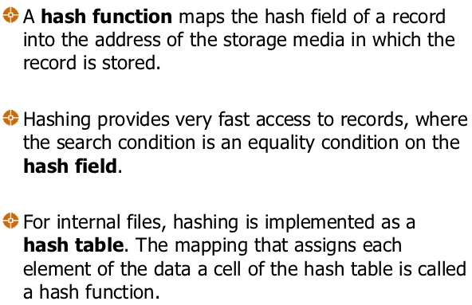
Hashing Technique

Slide 36
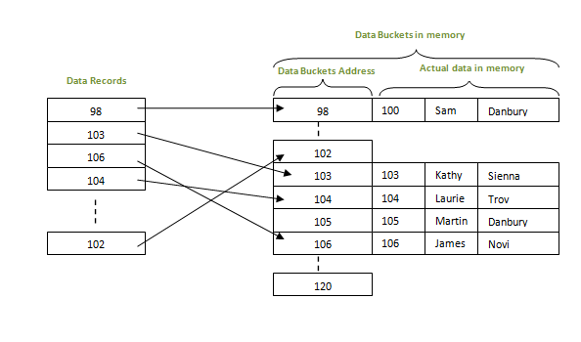
where data is stored at the data blocks whose address is generated by using hash function. The memory location where these records are stored is called as data block or data bucket. This data bucket is capable of storing one or more records.

Slide 37
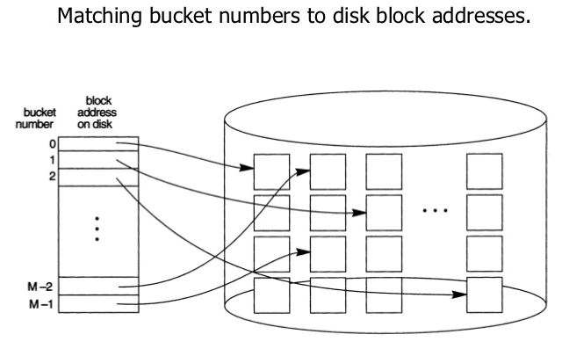
Hashing Technique

Slide 38
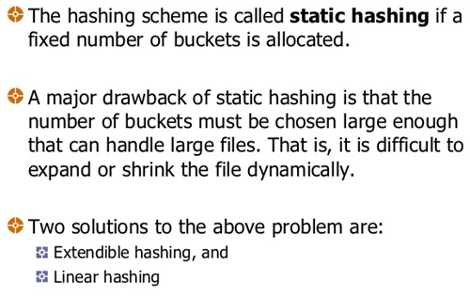
Hashing Technique

Slide 39
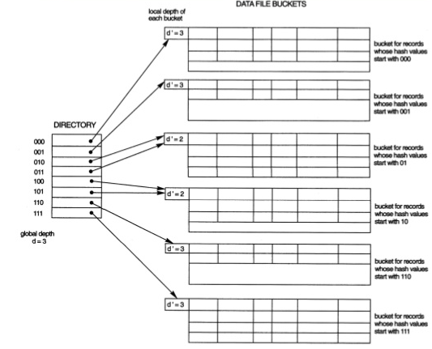
Structure of extendible hashing

Slide 40
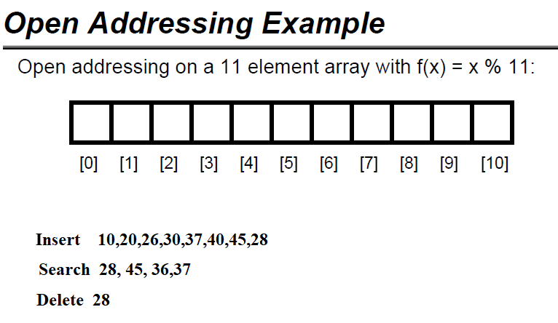
Problems:

Slide 41
THANK YOU

